Slide 1
Wikipedia & Covid-19 Kyle Ashburn Professor Sayamindu Dasgupta INLS 490.278

Slide 2
Agenda
___________________________________________
Questions
Why this?
Prior Work
Data & Method
Results
Limitations

Slide 3
Questions
___________________________________________
Do the Wikipedia Articles for respiratory outbreaks have a similar page view trend to Covid-19’s?
My hypothesis is they will.
Do the editors of those articles overlap?
My hypothesis is they will.

Slide 4
Why this project?
___________________________________________
We’re in the midst of a global pandemic and we need to understand the information ecosystem people rely on.

Slide 5
Prior Work
___________________________________________
Wikipedia activity as a measure of interest (Yoshida et al. 2015, Kampf et al. 2015, Mahroum et al. 2018)
Wikipedia as a source of health info (Laurent & Vickers 2009)
Wikipedia redirects (Hill & Shaw 2014)

Slide 6
Data & Method
___________________________________________
Pageview Statistics & Edit history
Collected through the Wikipedia API

Slide 7
Results(…)
___________________________________________
I was wrong…
The pageviews seem to be following the same pattern…more or less…
The editor lists are slightly related…but no more than other pages…

Slide 8
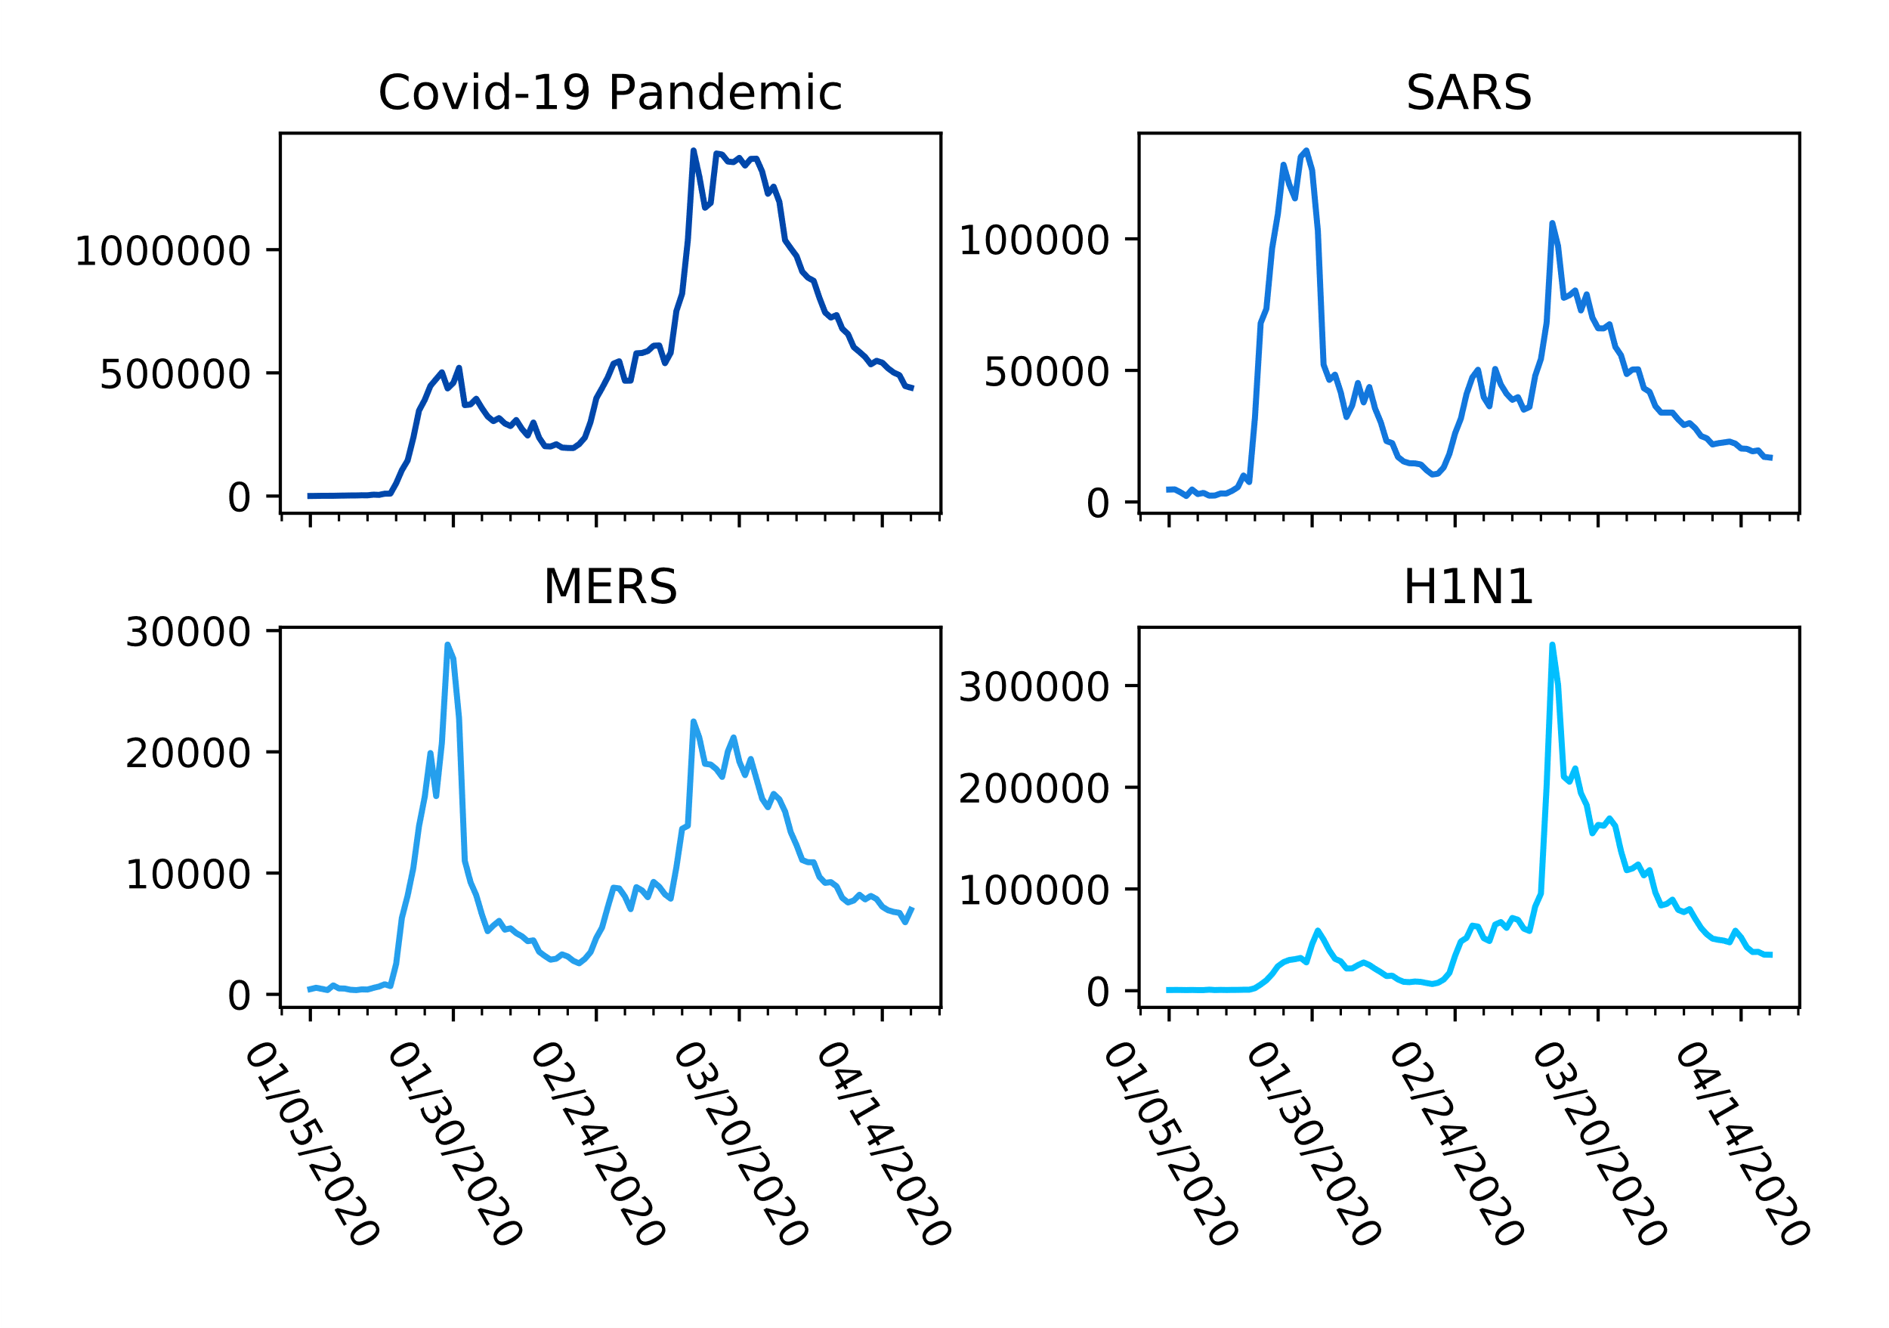
Pageviews
___________________________________________

Slide 9
Editor Overlap
___________________________________________
Pages Compared (top n editors) | Jaccard Similarity
MERS & Covid Pandemic (100) | 0.036
SARS & Covid Pandemic (100) | 0.02
H1N1 & Covid Pandemic (100) | 0.03
MERS & Covid Pandemic (10) | 0.05
SARS & Covid Pandemic (10) | 0.05
H1N1 & Covid Pandemic (10) | 0.0

Slide 10
Limitations
___________________________________________
I only looked at the English Language Wikipedia…
The editors may change over time – it’s not necessarily stable…
Article names change & redirects aren’t counted…

Slide 11
Works Cited
___________________________________________
Yoshida, Mitsuo, et al. “Wikipedia Page View Reflects Web Search Trend.” Proceedings of the ACM Web Science Conference on ZZZ - WebSci '15, June 2015, doi:10.1145/2786451.2786495.
Mahroum, Naim, et al. “Public Reaction to Chikungunya Outbreaks in Italy—Insights from an Extensive Novel Data Streams-Based Structural Equation Modeling Analysis.” Plos One, vol. 13, no. 5, 24 May 2018, doi:10.1371/journal.pone.0197337.

Slide 12
Works Cited (cont.)
___________________________________________
Laurent, M. R., and T. J. Vickers. “Seeking Health Information Online: Does Wikipedia Matter?” Journal of the American Medical Informatics Association, vol. 16, no. 4, 2009, pp. 471–479., doi:10.1197/jamia.m3059.
Kämpf, Mirko, et al. “The Detection of Emerging Trends Using Wikipedia Traffic Data and Context Networks.” Plos One, vol. 10, no. 12, 31 Dec. 2015, doi:10.1371/journal.pone.0141892.

Slide 13
Works Cited (cont.)
___________________________________________
Hill, Benjamin Mako, and Aaron Shaw. “Consider the Redirect.” Proceedings of The International Symposium on Open Collaboration - OpenSym '14, Aug. 2014, doi:10.1145/2641580.2641616.

Slide 14
Questions?
___________________________________________
Meaning of Life? -42
How many licks to get the center of a Tootsie-Pop?
- We may never know
When will I graduate?
– Eventually probably (Hopefully never)

Slide 15
Bonus!
___________________________________________
I found some code that makes graphs render more cleanly
%config InlineBackend.figure_format = 'retina'

